Slide 1
Hypertension Analysis
Simin & Zoey

Slide 2
Agenda
01
02
03
04
Data
Overview
Background & Data Source
Collection – Preprocessing
Feature Engineering – EDA
Conclusion & Future work
Model
Random Forest
Decision Tree Logistic Regression XGBoost
Tips to avoid Hypertension Ways to improve model

Slide 3
Overview
47%
>500,000
$131 Billion
Definition:
American College of Cardiology and American Heart Association’s (ACC/AHA)[2]
systolic blood pressure (SBP) > 130
OR
diastolic blood pressure (DBP) > 80
Now taking prescribed medicine for
High Blood Pressure
adults in the United States has hypertension[3]*
deaths in the United States had hypertension as a primary or contributing cause, in 2019[3]*
Dollars were cost because of High blood pressure in the United States averaged over 12 years from 2003 to 2014*
* Source: CDC

Slide 4
02
Data
Data Collection
Data Preprocessing
Feature Engineering
Exploratory Data Analysis (EDA)

Slide 5
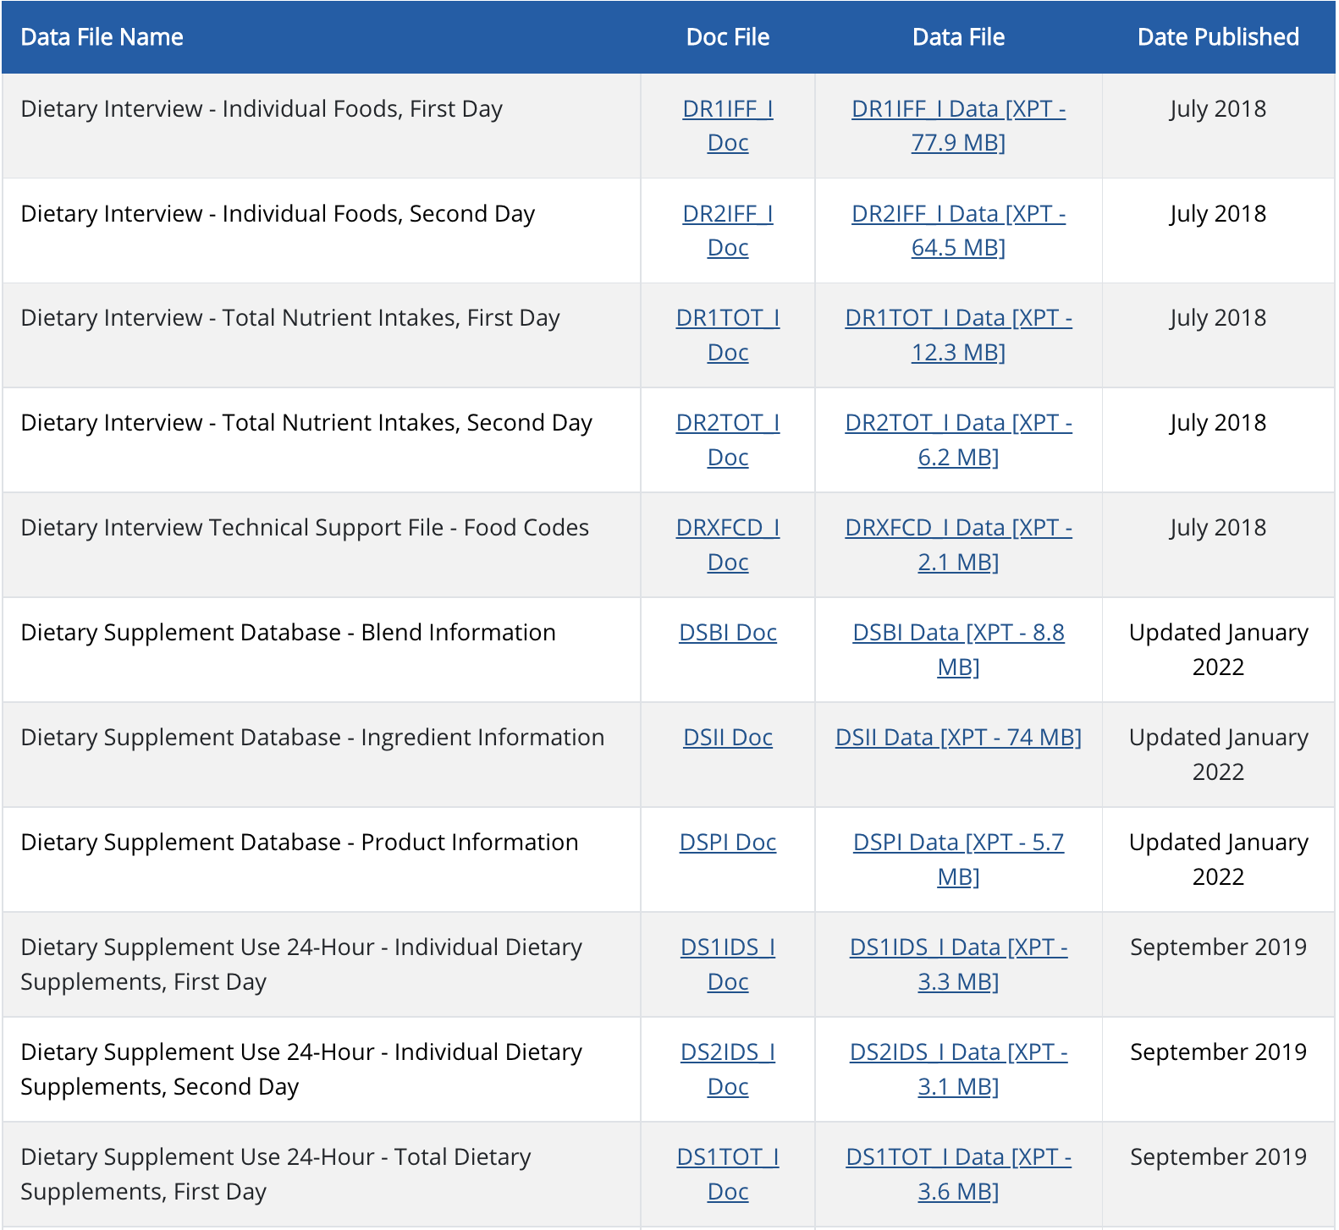
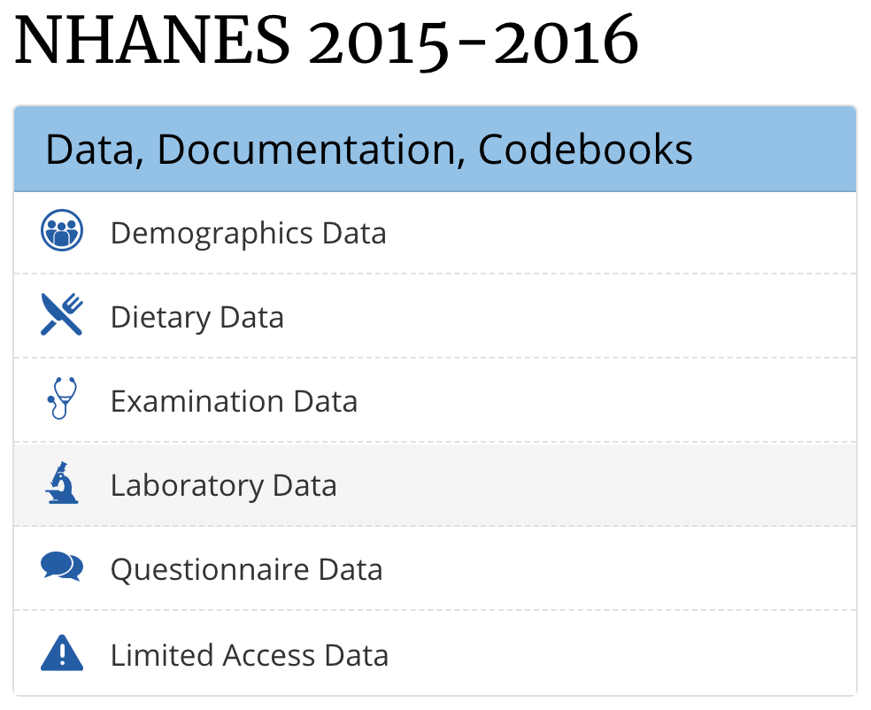
Data Collection
Data Source:
National Health and Nutrition Examination Survey[4]
Time Range: 2007 - 2018
BeautifulSoup to download 114 files

Slide 6
Data Detail
Demographic
Age
Gender
Race
Marital Status
Education
Income
1 file 43 columns
Dietary (Nutrient intakes)
Vitamin A
Iron
Alcohol
Caffeine
Octadecenoic
2 files 226 columns
Examination
Body Measurements
Blood Pressure
2 File 6 columns
Questionnaire
Consumer Behavior
Smoking
Mental Health
Diabetes
Sleeping Disorder
12 files 36 columns

Slide 7
Data Preprocessing
44584 Rows
290 Columns
35779 Rows
202 Columns
35779 Rows
202 Columns
Fill missing Value (iterative imputation)
Collected Data
Delete unnecessary group in categorical variables (< 10 samples)
Numerical
Bayesian Ridge with iteration with 10
Combine 12 years data
Remove rows and columns with too many missing values
Columns: > 20% missing
Rows: > 10% missing
Categorical Random Forest with iteration 4

Slide 8
235 Features
Feature Engineering Variance Inflation Factor (VIF)
VIF indicates the level of correlation between a given explanatory variable and other explanatory variables in the model
When significant multicollinearity issues exist, the variance inflation factor will be very large for the variables involved.
Eliminate collinear variables, resolving the multicollinearity issue.
185 Features
Delete features if VIF>10

Slide 9
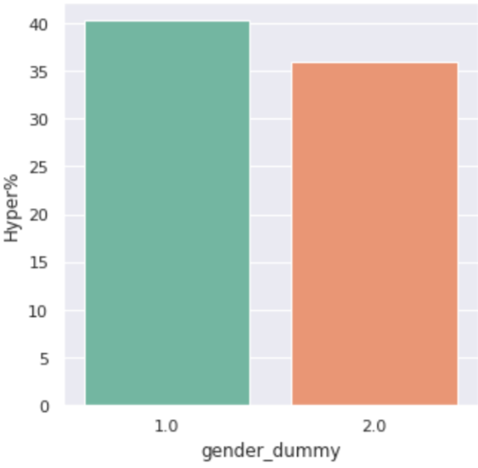
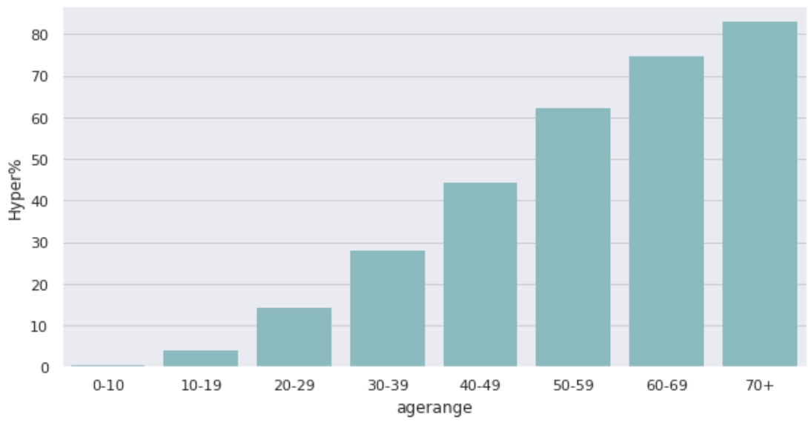
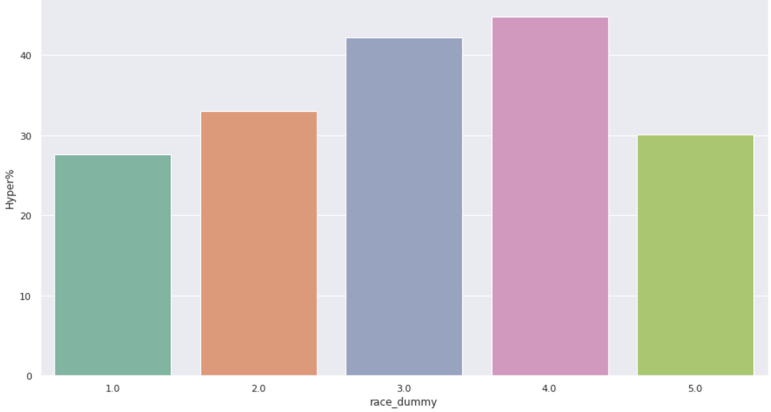
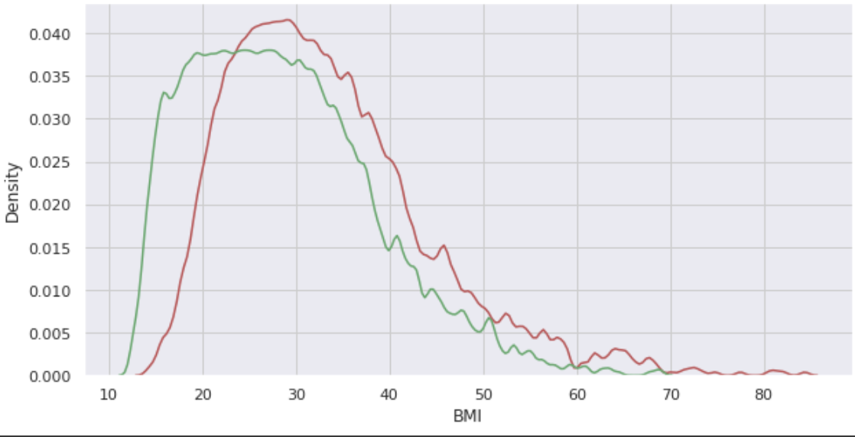
EDA
Age
Gender
Race
BMI
Male
Female
Without Hypertension
With Hypertension
Mexican
Hispanic
White
Black
Other

Slide 10
03
Model
Modeling
Evaluation
Important features

Slide 11
Model Evaluation (Validation data set)
 | Training F1 | Validation F1 | Training AUROC | Validation AUROC
Logistic Regression* | 0.755 | 0.749 | 0.891 | 0.885
Decision Tree** | 0.753 | 0.743 | 0.876 | 0.869
Random Forest | 1.0 | 0.728 | 1.0 | 0.874
XGBoost | 0.768 | 0.749 | 0.901 | 0.887
* Applied standard scaler before using logistic regression
** Use cross_validation to select optimal max depth for decision tree

Slide 12
Top 7 Features on each model
Age
Logistic Regression
Decision Tree
Age
ARM
CIRC
Waist
CIRC
Random Forest
Age
XGBoost
Age
Waist
CIRC
Race (Black)
Arm CIRC
Octadecanoic
No Diabetes
Race (Other)
Race (Black)
Waist
CIRC
Arm CIRC
No Diabetes
Caffeine
Height
Vigorous
recreational
activities
Waist
CIRC
Arm CIRC
Race (Black)
Height
Eicosenoic
Gender (Female)

Slide 13

Model Evaluation (Validation data set)
 | Precise (AUROC) | Explainable
Logistic Regression | High (0.89) | High
Decision Tree | Mid (0.87) | High
Random Forest | Mid (0.87) | Mid
XGBoost | High (0.89) | Mid

Slide 14
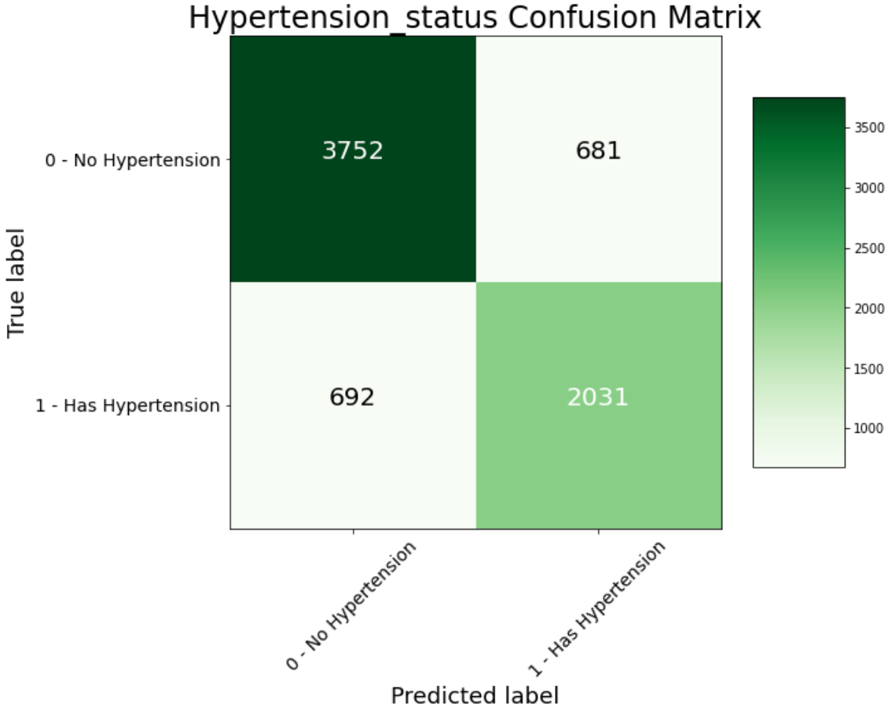
Test result
AUROC 0.88
F1 0.75

Slide 15
Cross Comparison
 | Model | AUC Score
Our Model | Logistic Regression | 0.885
A novel predicted model for hypertension based on a large cross-sectional study | Logistic Regression | 0.765
Predicting hypertension using machine learning: Findings from Qatar Biobank Study | Decision Tree | 0.79
An artificial neural network approach for predicting hypertension using NHANES data | Neural Network | 0.77

Slide 16
04
Recommendation & Future work

Slide 17
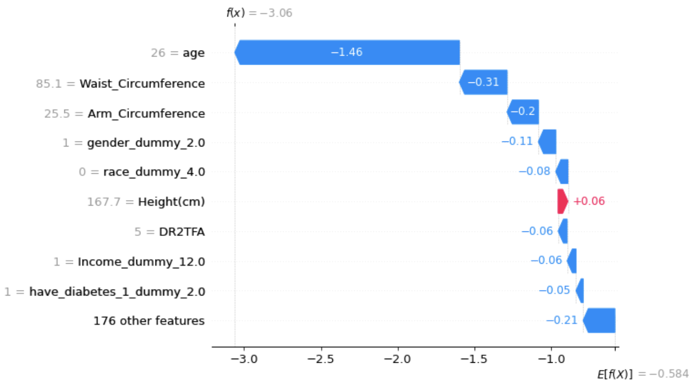
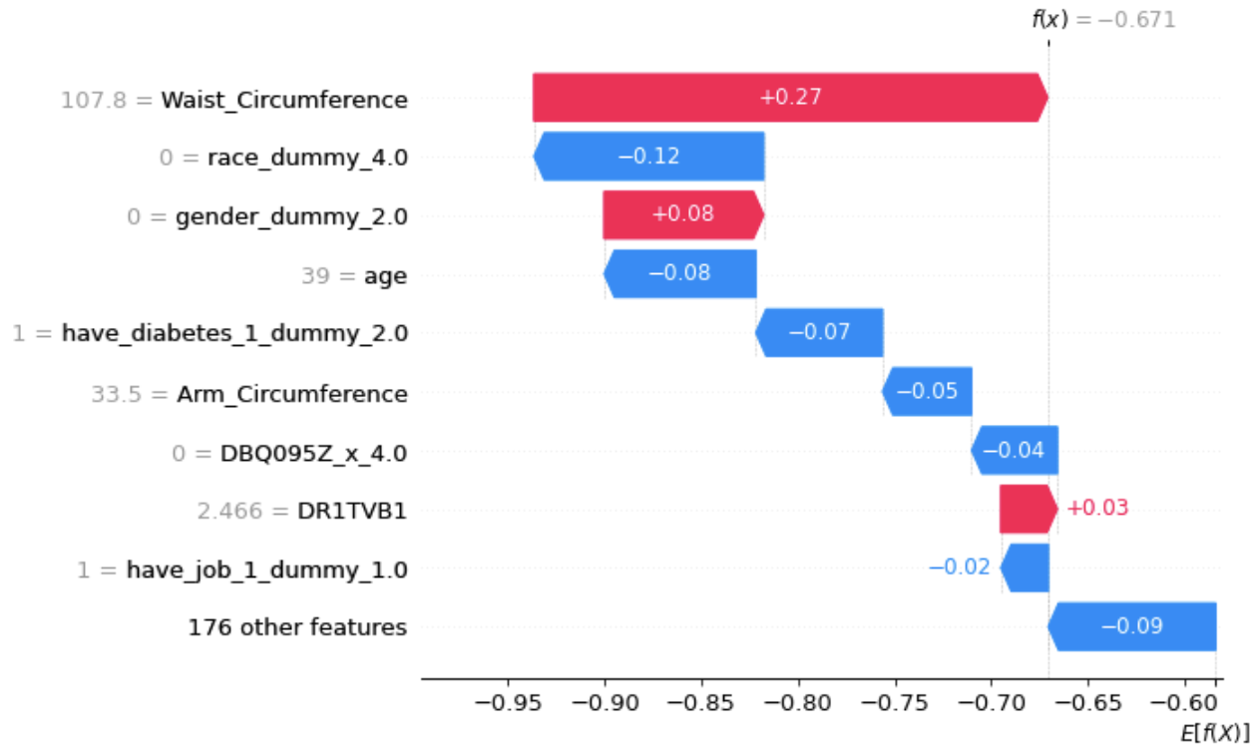
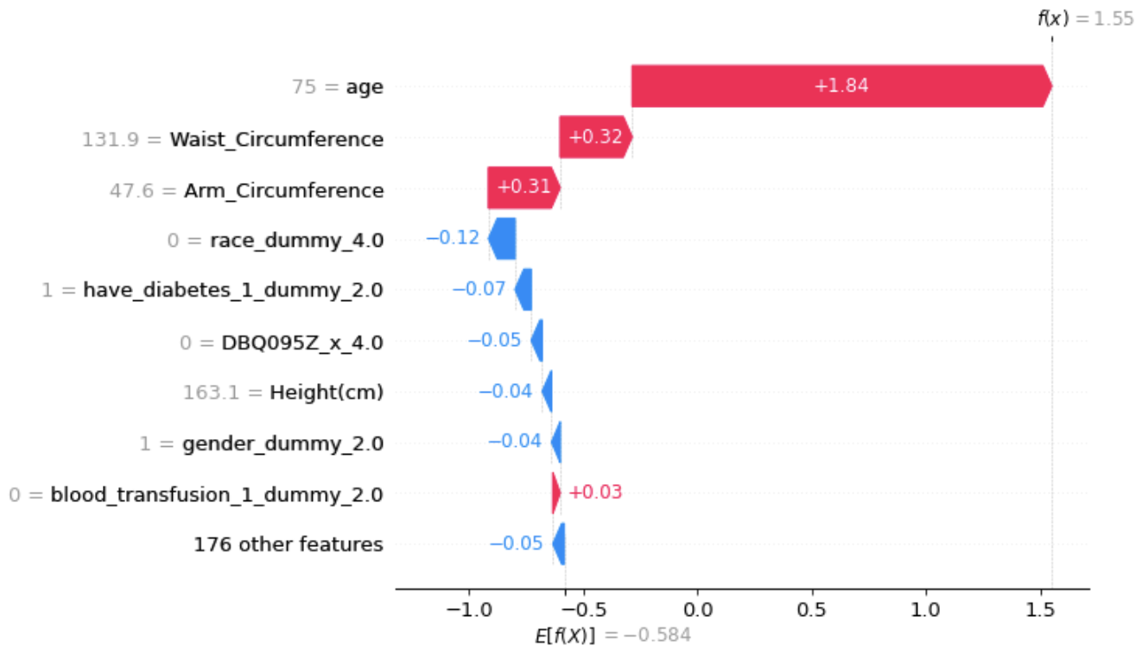
Interviewee Samples
Interviewee #1
Interviewee #2
Interviewee #3

Slide 18
Recommendations & Findings
Common Features form 4 Models
Age
Waist CIRC
Arm CIRC
General recommendation: Work Out and Eat Healthy!!!
Interesting Findings:
Octadecanoic is help to reduce the risk of Hypertension( Cheese, Milk)
Caffeine is positively associated with Hypertension (<200mg/Day)
Female are more likely to have hypertension
Age have clearly positive correlation with the risk of hypertension
Race-Black is also associated with hypertension

Slide 19
Feature Work
Applied deep learning model and dropping method to calculate the inference of each features.
Create more sophisticated grouping method on all columns, and identify the effect based on the group.
Generate text suggestions automatically using SHAP library to reduce the risk of hypertension automatically

Slide 20
Thanks!
Do you have any questions?
Please keep this slide for attribution

Slide 21
Reference
http://aha-clinical-review.ascendeventmedia.com/books/aha-high-blood-pressure-toolkit/14/
https://millionhearts.hhs.gov/data-reports/hypertension-prevalence.html
https://www.cdc.gov/bloodpressure/facts.htm#:~:text=Having%20hypertension%20puts%20you%20at,death%20in%20the%20United%20States.&text=In%202019%2C%20more%20than%20half,a%20primary%20or%20contributing%20cause.
https://wwwn.cdc.gov/Nchs/Nhanes/
https://www.investopedia.com/terms/v/variance-inflation-factor.asp#:~:text=Variance%20inflation%20factor%20measures%20how,standard%20error%20in%20the%20regression.
https://journals.plos.org/plosone/article?id=10.1371/journal.pone.0240370
https://www.nature.com/articles/s41598-020-64980-8
https://www.nature.com/articles/s41598-020-67640-z#ref-CR29
https://github.com/ZoeyYuZhou/Health_Analytics_FP (model uploaded)

